Slide 1
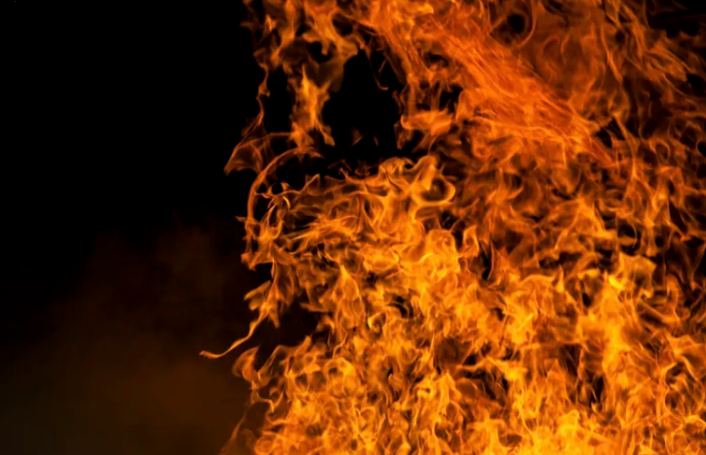
The Science of Combustion

Slide 2
Slide 2
https://disney.fandom.com/f/p/4400000000000297833

Slide 3
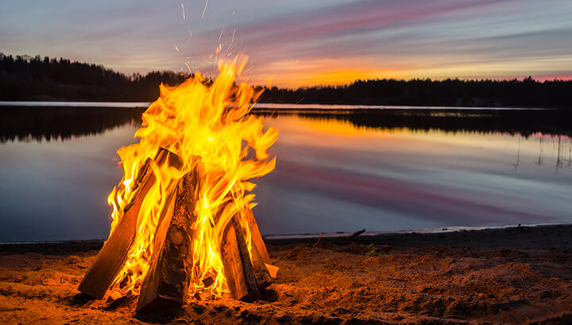
Warm-up Questions
How/when does fire help us?
How/when does fire does not help us?
https://www.meditationdaily.com/meditative-benefits-of-staring-into-a-fire/
Slide 3

Slide 4
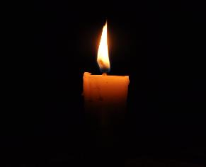
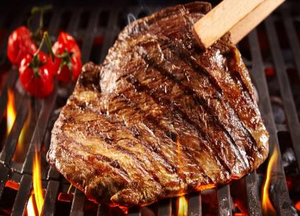
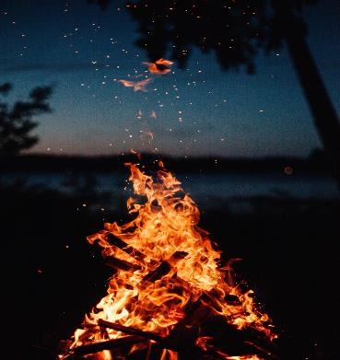
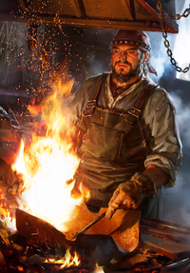
How Fire helps
Lighting
During night or in dark places
Cooking of foods
Make safe to eat
Make easier to chew/digest
Make tastier
Manufacturing of tools
Melt metals
Make glass and fire ceramics
Original ”air conditioning”
Fun/entertainment
https://en.wikipedia.org/wiki/Candlepower
https://www.muscleandfitness.com/nutrition/healthy-eating/5-best-meats-throw-grill/
Slide 4
https://unsplash.com/photos/1j18807_ul0
https://witcher.fandom.com/wiki/Blacksmith

Slide 5
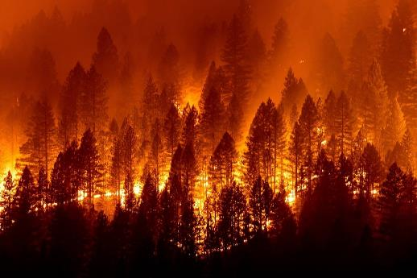
Wildfires: Combustion and Arid lands
Natural wildfires are part of the natural ecosystem
When?
Sparks or fires from human activities
Naturally occurs by lightning
Most often occurs during summer and Fall when the biomass is driest
Benefits of natural-occurring wildfire
Clears weaker trees and debris
Open the forest floors to sunlight
Nourishes the soil
Reduces the severity of future wildfires
https://www.britannica.com/science/wildfire
Slide 5

Slide 6
WATCH AND OBSERVE
Building a Fire to Burn Green Wood
https://www.youtube.com/watch?v=mWErKjSRz4M
How To Make and Sustain a Fire in The Rain
https://www.youtube.com/watch?v=L-5g7-AyqHA
Slow-Motion Wood Burning
https://www.youtube.com/watch?v=1pSe4qG-XcM
Slide 6

Slide 7
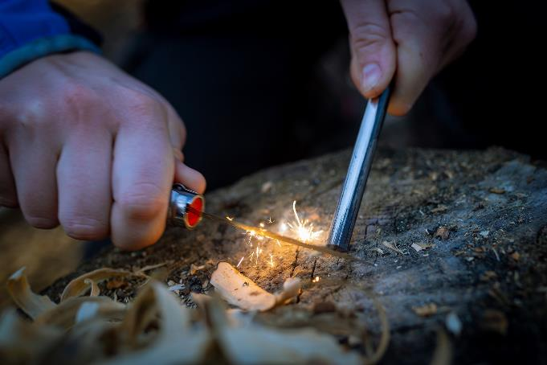
Ignition question
What are some things that can prevent a fire from starting?
https://www.mensjournal.com/health-fitness/the-surprising-health-benefits-of-making-a-campfire/
Slide 7

Slide 8
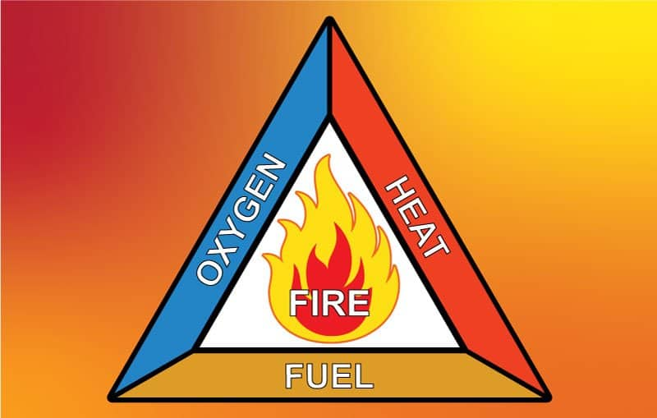
fire triangle
Oxygen
Fuel
Energy content
Ability to start combustion reactions
Ignition source
https://andersonscanada.com/2019/03/25/safety-the-fire-triangle/
Slide 8

Slide 9
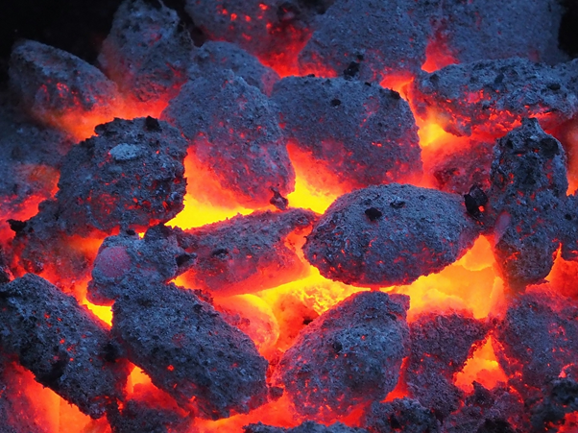
The science of combustion
4 steps
Drying
Pyrolysis
Flaming Pyrolysis
Char Combustion
https://medium.com/age-of-awareness/coal-why-we-should-not-burn-it-9a6894a3fcfe
Slide 9

Slide 10
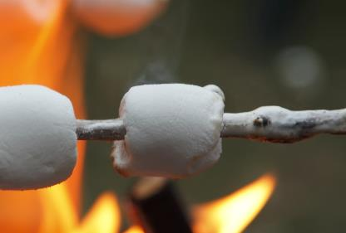
Drying
Happens near the boiling point of water
White “smoke” - Steam
Steam is a vapor, which disappears quickly
No flame
No smell
Slide 10

Slide 11
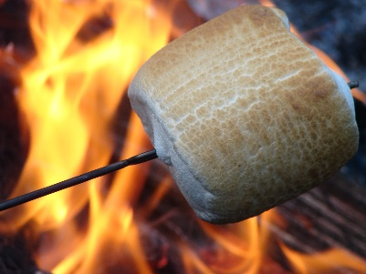
Pyrolysis (“cut with fire”)
Starts between 250$°$C and 350$°$C for wood/paper
Molecules in the fuel are broken into smaller pieces and escape
Brown or yellow smoke, which doesn’t disappear
Smoke = Aerosols (tiny droplets of liquid)
Only needs heat
No flame
Can happen with or without oxygen
“Fire” smell starts
Slide 11

Slide 12
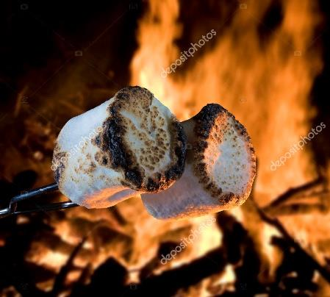
Flaming Pyrolysis
Aerosols in the gas mix with oxygen and burn producing heat, light, carbon dioxide (CO₂), water
Brown/yellow smoke, which persists
Flame
Much stronger smell of burning wood
More CO₂ is produced than in pyrolysis
Slide 12

Slide 13
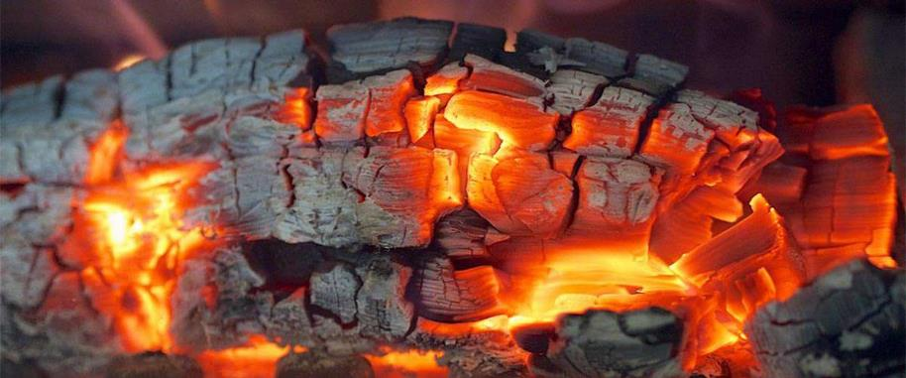
Char Combustion
No more flame
Still very hot
Slow, solid burning of solids
Blue/white smoke which persists
No flame
More oxygen = more heat (glowing coals)
Less smell
Carbon dioxide (CO₂) and carbon monoxide (CO) are produced
Slide 13

Slide 14
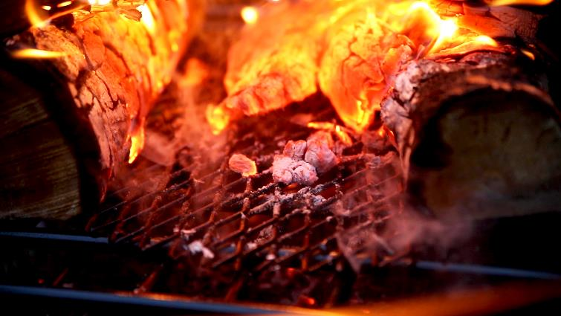
Burning question
What is left over after a fire?
https://www.waldenbackyards.com/blogs/tips-and-tricks/the-benefits-of-an-ember-catcher
Slide 14

Slide 15
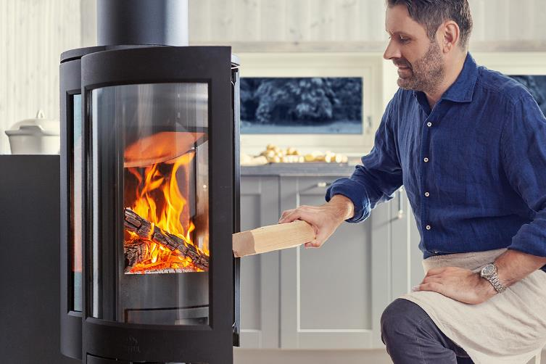
Problems with fire: Not hot enough ?
You need to:
Dry fuel
Add oxygen (use bellows)
Insulate the walls (less heat loss)
https://www.jotul.co.uk/tips-and-tricks/how-light-fire
Slide 15

Slide 16
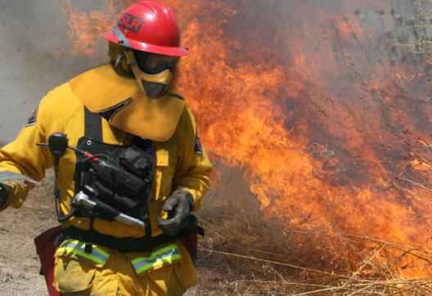
Problems of fire: Carbon Monoxide (CO)
You need to:
Add oxygen
Increase residence time/contact
CO poisoning
CO blocks body’s ability to bind oxygen
People can suffocate even when O₂ is present
$C$ $CO$ ${ CO}_{2}$
https://depts.washington.edu/design13/?p=3741
Partially oxidized
Completely oxidized
Slide 16

Slide 17
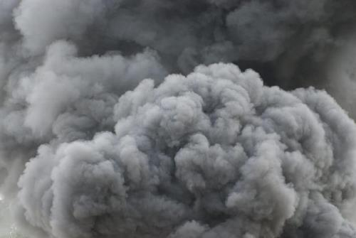
Problems of fire: smoke
What is “smoke”?
Aerosols (liquids)
Soot (solids)
Vapors (gases)
Smoke is a result of an incomplete combustion
Incomplete combustion often produces undesired products
https://www.reddit.com/r/Warthunder/comments/olfchf/ostwind_ii_firing_perspective/
Slide 17

Slide 18
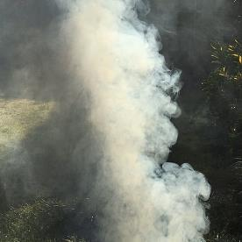
Problems with fire: smoke
If propane (C₃H₈) reacts with some oxygen (O₂) it will give soot/carbon (C), Water (H₂O)
$2C_{3}H_{8}+4O_{2}→6C+{8H}_{2}O$
If propane (C₃H₈) reacts with some oxygen (O₂) and enough energy, it will give carbon monoxide (CO), carbon Dioxide (CO₂) and Water (H₂O)
${2C}_{3}H_{8}+9O_{2}+heat→4CO_{2}+2CO+8H_{2}O$
Carbon monoxide (CO) and soot/carbon (C) emitted are undesirable products
Slide 18
https://www.texasmonthly.com/bbq/avoiding-dirty-smoke/

Slide 19
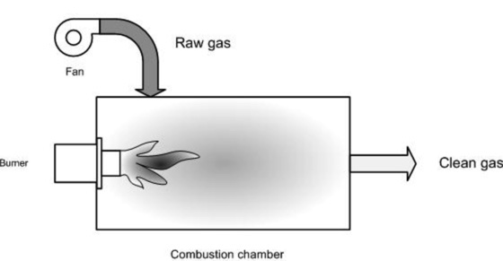
Problems with fire: smoke
Afterburners
add more heat and oxygen to complete combustion
produces a clean smokestack (just water and carbon dioxide)
Using the afterburner, propane reacts with enough oxygen and energy to produce a clean smokestack
Using an afterburner, propane (C₃H₈) reacts with enough oxygen (O₂) and enough energy, it will give carbon dioxide (CO₂) and water (H₂O)
2$C_{3}H_{8}+10O_{2}+heat→6CO_{2}+8H_{2}O$
Slide 19
https://emis.vito.be/en/bat/tools-overview/sheets/thermal-afterburning

Slide 20
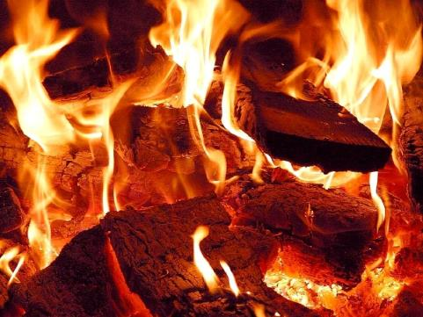
Fuels: Biomass
How can biomass be fuel?
All types of biomass can be fuel
Combustion of biomass provides heat which can be directly or converted to power in engines and generators
Leftover biomass can be used as a renewable energy source
http://www.chem.ucla.edu/~harding/IGOC/C/combustion.html
Slide 20

Slide 21
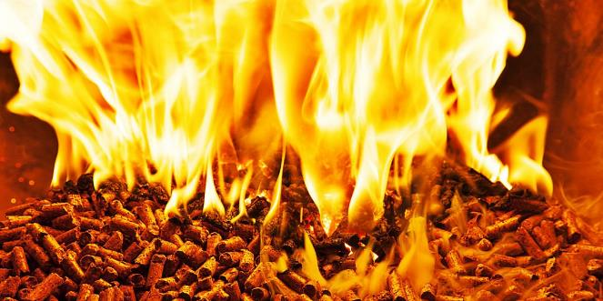
Fuels: Biomass
Examples of biomass
Waste wood
Pecan waste
Yard waste
Guayule Bagasse
Leftovers after rubber is removed from Guayule
https://www.borgenmagazine.com/consequences-biomass-burning-india/
Slide 21

Slide 22
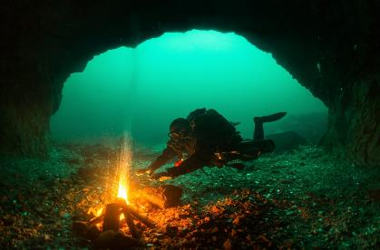
Oxidizers
Oxidizers are chemicals that provide oxygen to a fire
How can we have a fire under water?
Magnesium Nitrate decomposes in water to give oxygen
$2Mg{\left(NO_{3}\right)}_{2}→2MgO+4NO_{2}+O_{2}$
https://www.storytrender.com/59918/amazing-illusions-appear-to-show-diver-creating-bonfire-underwater/
Slide 22

Slide 23
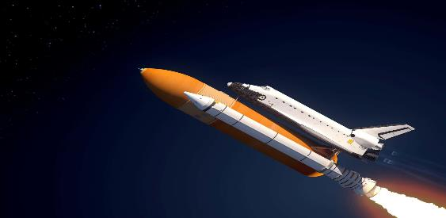
Oxidizers
How can we have a fire in space?
Ammonium Perchlorate decomposes to give oxygen for the combustion of rocket fuel
https://www.scienceabc.com/nature/universe/since-fire-needs-oxygen-to-burn-how-do-rockets-work-in-the-vacuum-of-space.html
$$2NH_{4}ClO_{4}→{Cl}_{2}+N_{2}+{2O}_{2}+{4H}_{2}O$$
Slide 23

Slide 24
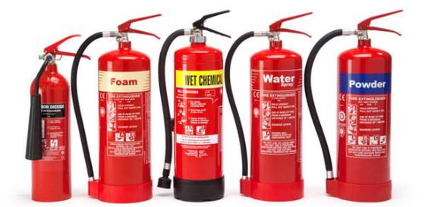
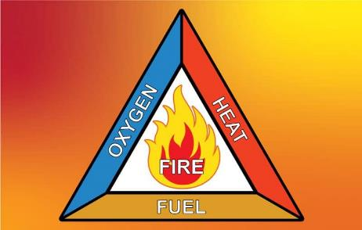
How to extinguish a fire?
Each extinguisher removes part of the fire triangle
https://ohsonline.com/Articles/2004/08/The-ABCs-Ds-and-Ks-of-Fire-Extinguishers.aspx
https://andersonscanada.com/2019/03/25/safety-the-fire-triangle/
Slide 24

Slide 25
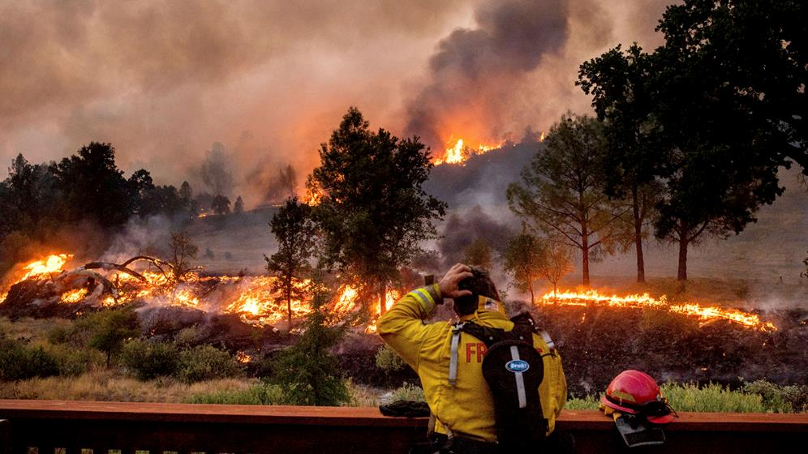
Wildfire Question
Using the fire triangle, what can we do to limit wildfires?
https://abc7news.com/california-fire-season-ca-wildfires-wildfire-bay-area/10575293/
Slide 25

Slide 26
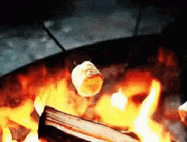
S'mores Activity
Time to (safely) explore fire
Write down the observations you see
Sight
Smell
Sound
Touch (feel heat—do not actually touch!)
Taste (change in marshmallow flavor—do not eat fire!)
https://tenor.com/search/roasting-marshmallows-gifs
Slide 26

Slide 27
Author Biographies Catherine Brewer is an associate professor at the Department of Chemical and Materials Engineering at New Mexico State University.
Jacob Ursey is a Master’s student in the Department of Chemical and Materials Engineering at the New Mexico State University.
Shermal Fernando is a PhD student in the Department of Chemical and Materials Engineering at the New Mexico State University.
Sustainable Bioeconomy for Arid Regions Center of Excellence: https://sbar.arizona.edu
Any opinions, findings, conclusions, or recommendations expressed in this PowerPoint lesson are those of the author(s) and do not necessarily reflect the view of the U.S. Department of Agriculture. Grant # 2017-68005-26867.
Slide 27

