Slide 1
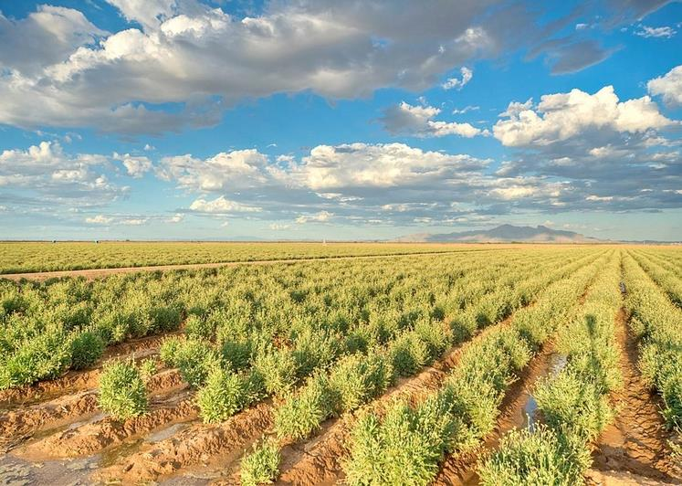
What is a Bioeconomy? Arisbeth Ibarra Nieblas The University of Arizona

Slide 2
Day 1 Introduction to Bioeconomony
Objectives:
Define a bioeconomy
Differentiate between nonrenewable and renewable sources
Describe advantages and challenges to creating a bioeconomy

Slide 3
Imagine that your class has landed on a far away planet that has no other people or cities or towns . . .
It just so happens that this planet looks exactly like the Sonoran Desert!
You did not bring anything except the clothes you are wearing and drinking water. You'll be
here for one month . . . What will you do?

Slide 4
This is the Sonoran Desert!
It has a hot and dry climate.
The native plants either need little water to survive, are drought resistant, or can avoid drought.
Animals in the desert get most of their water from their food.
Palo Verde tree
Sabino Creek--Tucson, Arizona
Saguaro
Cactus

Slide 5
In groups answer the following questions. . .
The problem is how to survive (shelter and food) and thrive (happiness and business) in the new planet.
What could your group use for shelter?
What could your group eat?
What would your group do for fun?
What would your group make to trade with the other groups for a value? (This one is important for groups to thrive.)

Slide 6
As a class let’s discuss . . .
The problem was how to survive (shelter and food) and thrive (happiness and business) in the new planet.
Would any group want to trade something with the other groups for a value?

Slide 7
Bioeconomy
An economy is the production and distribution of goods and services in a society
A bioeconomy is the system of making products derived from renewable materials and trading them for a value
Bio
economy

Slide 8
Sources used to make products (goods)
Non-renewable sources will run out or will not be replenished for a long time.
Renewable sources can grow again or never run out.

Slide 9
Fossil fuels are non-renewable sources
Fossil fuels took million of years to be produced.
From fossil fuels we can produce electricity, plastics, paint, medicine, gasoline, diesel, jet fuel, asphalt, and much more.
How much do humans depend on fossil fuels?
In 2018, around 80% of energy production in the USA was from fossil fuels.
(Source: https://www.eia.gov/todayinenergy/detail.php?id=41353)
Examples of fossil fuels are coal, natural gas, and petroleum (oil).
Coal
Natural gas
Petroleum (oil)
Notes:
In 2018, around 80% of energy production in the USA was from fossil fuels.
Source: https://www.eia.gov/todayinenergy/detail.php?id=41353

Slide 10
Plants are renewable sources
Plants can grow over and over again.
From plants we can produce energy, medicine, vehicle tires, plastics, biodiesel fuel, clothing and much more.
Field of guayule in Arizona.

Slide 11
Bioeconomy example
Raw material
Grow
Production
Retail
Usage
Recycle
Bioeconomy

Slide 12
Linear economy example
Raw material
Production
Retail
Usage
Disposal

Slide 13
In groups do the following research . . .
Group 1 – Advantages for humans in a bioeconomy
Group 2 – Advantages for the environment in a bioeconomy
Group 3 – Advantages for businesses in a bioeconomy
Group 4 – Challenges related to creating a bioeconomy
Group 5 – Environmental considerations for a bioeconomy
Group 6 – Challenges for businesses in a bioeconomy
Every group needs to find at least 2 things for their list.

Slide 14
Advantages and challenges of bioeconomies
 | Social (humans) | Environmental | Economic (trade/business)
Advantages
Challenges

Slide 15
Day 2 Life Cycle of a Product
Objectives:
Learn and examine the environmental life cycle of common products
Create an environmental life cycle of a product
Explain the importance of understanding the life cycle of the products we use

Slide 16
In pairs answer the following questions…
What happens to products (for example: computers, cellphones, jeans, tennis shoes, notebooks, pillows, food, cups) after we are done with them?

Slide 17
Environmental life cycles
The production of goods has a big impact on the environment.
Environmental life cycles of products are important because they help us determine the impact products have on the environment.
An environmental life cycle of a product describes the stages of the life of a product:
Raw materials
Production
Transportation
Retail and usage by consumer
Recycling or disposal

Slide 18
Environmental life cycle example: Styrofoam plates
Raw materials
Production
Transportation
Retail and usage by consumer
Disposal
In 2017, around 8% of waste was recycled.
(Source: https://www.livescience.com/how-much-plastic-recycling.html)
Styrofoam decomposes in about 500 years.
(Source: https://sciencing.com/facts-about-landfill-styrofoam-5176735.html)
Notes:
Source: https://www.livescience.com/how-much-plastic-recycling.html
Source: https://sciencing.com/facts-about-landfill-styrofoam-5176735.html

Slide 19
Environmental life cycle example Sugarcane plates
Raw materials
Production
Transportation
Retail and usage by consumer
Recycling (compost)
Sugarcane products decomposes in about 90 days in the right conditions.
(Source: https://www.eccocane.org/)
Disposal
Biodegradable products need specific environments to decompose.
These will not decompose the same at the landfill than in an industrial composting plant.
Sources:
http://www.allthings.bio/dispose-bio-based-plastics/
https://www.epa.gov/trash-free-waters/frequently-asked-questions-about-plastic-recycling-and-composting#home
Notes:
https://www.eccocane.org/why-sugarcane-bagasse#:~:text=Bagassse%20Sugarcane%20products%20normally%20biodegrade,%2C%20turnover%20rate%2C%20moisture%20etc.
http://www.allthings.bio/dispose-bio-based-plastics/
https://www.epa.gov/trash-free-waters/frequently-asked-questions-about-plastic-recycling-and-composting#home

Slide 20
In groups research the following ...
Group 1 – Life cycle of a pair of jeans
Group 2 – Life cycle of a plastic water bottle
Group 3 – Life cycle of a cell phone
Group 4 – Life cycle of organic bamboo straws
Group 5 – Life cycle of a teabag
Group 6 – Life cycle of a palm leaf plate
Each group will make a poster of their life cycle and present it to the class.

Slide 21
Individually answer the following questions…
Describe one advantage of bioeconomies.
Describe one challenge of bioeconomies.
3. Describe or draw the typical life cycle of a biodegradable product.

Slide 22
Arisbeth Ibarra Nieblas
University of Arizona
Arisbeth is a third-year doctoral student in Environmental Engineering at the University of Arizona. She majored in Chemical Engineering at the Technological Institute of Sonora (ITSON), Ciudad Obregon, Mexico. Her graduate research involves developing a continuous corrosion monitoring station for water delivery pipe metal. As a third-year SBAR Fellow, Arisbeth continues to create educational content for middle school-aged students, including science experiments and activities that involve complex topics like bioeconomy.
Any opinions, findings, conclusions, or recommendations expressed in this PowerPoint lesson are those of the author(s) and do not necessarily reflect the view of the U.S. Department of Agriculture. Grant # 2017-68005-26867.

