Slide 1
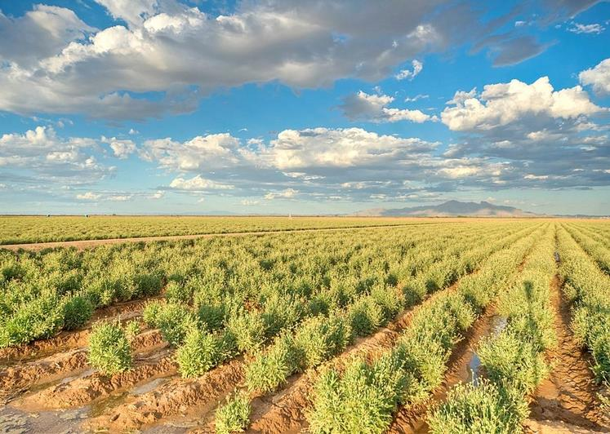
What are Bioproducts? Arisbeth Ibarra Nieblas The University of Arizona

Slide 2
Day 1 Introduction to Bioproducts
Objectives:
Define a bioproduct
Differentiate between nonrenewable and renewable sources
Recognize the connection between agriculture and bioproducts

Slide 3
This is the Sonoran Desert!
It has a hot and dry climate.
The native plants either need little water to survive, are drought resistant, or can avoid drought.
Animals in the desert get most of their water from their food.
Palo Verde tree
Sabino Creek--Tucson, Arizona
Saguaro
Cactus

Slide 4
As a class . . .
1
2
3
List of plants in the Sonoran Desert
In your group . . .
Do online research to find products that are not food that we can make from the list of plants in the Sonoran Desert.
List of products that we can get from the plants that are not food
For example: Cactus.
For example: Vegan leather made from cactus.
For example: Vegan leather made from cactus.

Slide 5
As a class . . .
4
5
6
List of important products we use every day
In your group . . .
Pick one important everyday product which can be made from other products and make one poster.
Present poster to the class.
For example: A car.
For example: A car.

Slide 6
An important item we could make from our local plants are cars!
5
Car
Make car interior with plastic made from corn.
Make tires with rubber from guayule.
Make biodiesel with corn.
In your group . . .
Pick one important everyday product which can be made from other products and make one poster.
Example of poster
For example: A car.

Slide 7
Bioproducts
Products from plants that are not food or feed are called

Slide 8
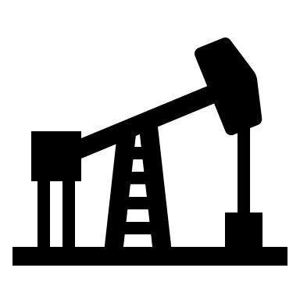
Sources used to make products
Non-renewable sources will run out or will not be replenished for a long time.
Renewable sources can grow again or never run out.

Slide 9
Fossil fuels are non-renewable sources
Fossil fuels took million of years to be produced.
From fossil fuels we can produce electricity, plastics, paint, medicine, gasoline, diesel, jet fuel, asphalt, and many more.
How much do humans depend on fossil fuels?
In 2018, around 80% of energy production in the USA was from fossil fuels.
(Source: https://www.eia.gov/todayinenergy/detail.php?id=41353)
Examples of fossil fuels are coal, natural gas, and petroleum (oil).
Coal
Natural gas
Petroleum (oil)
Notes:
In 2018, around 80% of energy production in the USA was from fossil fuels.
Source: https://www.eia.gov/todayinenergy/detail.php?id=41353

Slide 10
Plants are renewable sources
Plants can grow over and over again very quickly.
From plants we can produce energy, vehicle tires, plastics, biodiesel, clothing and much more.
Field of Guayule in Arizona.

Slide 11
Can we grow any type of plant anywhere?
No, different plants need different growing conditions.
How are the growing conditions different in the Sonoran Desert compared to other places?
Water
Sunlight
Soil
Climate
Water is not very abundant
Soil has a basic pH (7-8.5)
Climate is dry and hot
Full sun
Notes:
Water not very abundant, full sun, basic ph around 7-8.5, Dry climate

Slide 12
Which plant can we grow in the Sonoran Desert?
Blueberries
Soil pH: 3.5-4.4
Papaya
Soil pH: 5.5-6.5
Guayule
Soil pH: 6.0-8.5
Sun: Full sun
Temperature: 70-90°F
Habitat: Tropical
Sun: Full sun
Temperature: 90-100°F
Habitat: Desert
Sun: Full sun
Temperature: 35-55°F
Habitat: Temperate
Source:https://commons.wikimedia.org/wiki/File:Growing_blueberry.jpg
Source:https://commons.wikimedia.org/wiki/File:Organic_papaya_tree.JPG

Slide 13
Bioproducts in the Sonoran Desert
The growing conditions in an area determine the best crop to plant in the area.
Example:
Guayule is a desert plant that naturally grows in the Southwest part of the USA.
It is grown in Arizona and natural rubber is extracted to make tires for vehicles.
(Source: https://sbar.arizona.edu/research/characterizations-co-products)
Field of Guayule in Arizona.

Slide 14
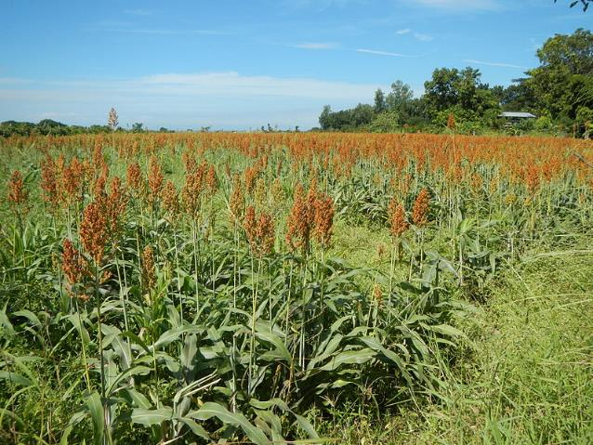
Bioproducts in the Sonoran Desert
The growing conditions in an area determine the best crop to plant in the area.
Example:
Sweet sorghum resembles corn, but it is much more drought and heat tolerant.
It can be grown in Arizona and scientists are working on using it to make biofuels.
(Source: https://be.arizona.edu/content/sweet-sorghum-biofuel)
Sweet Sorghum Field
Source:https://commons.wikimedia.org/wiki/File:JfSorghum_bicolor0067Philippinesfvf_07.JPG (a white border was added)

Slide 15
Individually answer the following questions…
Are bioproducts made from non-renewable sources or renewable sources? Explain your answer.
Can we grow any type of plant anywhere?
How do growing conditions limit bioproducts?

Slide 16
Day 2 Product Design Process
Objectives:
Learn examples of bioproducts
Design a bioproduct to solve a problem or need

Slide 17
In pairs answer the following questions…
What is a problem you, your family, your community, or the world has, that you would like to solve?
What current products are there to solve this problem?

Slide 18
Bioproducts
Products from plants that are not food or feed are called

Slide 19
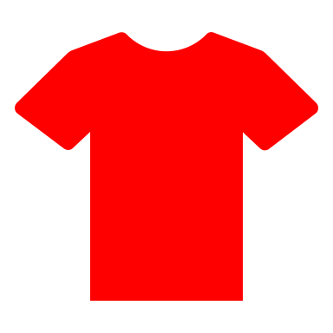
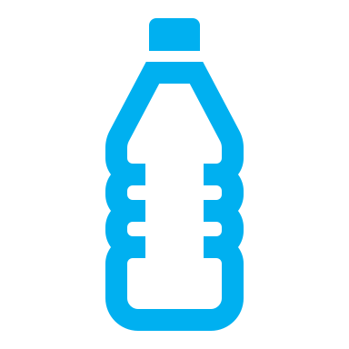
Examples of bioproducts
Corn
Soybean
Guayule
Ethanol
Textiles
Biopolymers
Xanthan gum
Vitamin C and Vitamin E
Amino acids
Citric and lactic acid
Candles
Textiles
Ink and paints
Adhesives
Cleaning supplies
Shampoo
Hand sanitizer
Biodiesel
Natural rubber
Organic resins
Biodiesel

Slide 20
Bioproducts solve problems
Farmers grow a particular plant
Scientists do research to learn how to solve the problem using the plant farmers are growing
Engineers use the plant and learned process from the scientists to solve the problem in a large scale
There is a problem or need in the world

Slide 21
Product Design Process
Define the problem
Do research
Brainstorm solutions
Design the product
Build a prototype
Test and redesign
Communicate results
What is the problem the product will solve? How will the product solve the problem?
Are there any other products that solve this problem? Who will use this product?
What are the specific requirements? Generate solutions to the problem.
Choose the best solution and develop the product.

Slide 22
In pairs do the following…
Solve a problem using a bioproduct.
Define the problem
Do research
Brainstorm solutions
Design the product
Use worksheet to complete the steps.

Slide 23
In pairs do the following (EXAMPLE)…
Solve a problem using a bioproduct.
Define the problem: I need a strong bag to carry my phone, wallet, and water bottle.
Do research: There are backpacks, purses, and bags in the market. Cactus can be used to make vegan leather. Cotton can be used to make cloth.
Brainstorm solutions: Make a small backpack that has an outside made of vegan leather from cactus, and inside cloth from cotton.
Design the product:
Outside is leather from cactus
Inside is made from cotton
Easy access front compartment for phone and wallet
Side compartment for water bottle

Slide 24
Individually answer the following questions…
What is a bioproduct?
Give 2 examples of bioproducts. What are they made of?
Name at least 2 steps of the product design process.

Slide 25
Arisbeth Ibarra Nieblas
University of Arizona
Arisbeth is a third-year doctoral student in Environmental Engineering at the University of Arizona. She majored in Chemical Engineering at the Technological Institute of Sonora (ITSON), Ciudad Obregon, Mexico. Her graduate research involves developing a continuous corrosion monitoring station for water delivery pipe metal. As a third-year SBAR Fellow, Arisbeth continues to create educational content for middle school-aged students, including science experiments and activities that involve complex topics like bioeconomy.
Any opinions, findings, conclusions, or recommendations expressed in this PowerPoint lesson are those of the author(s) and do not necessarily reflect the view of the U.S. Department of Agriculture. Grant # 2017-68005-26867.

