Slide 1
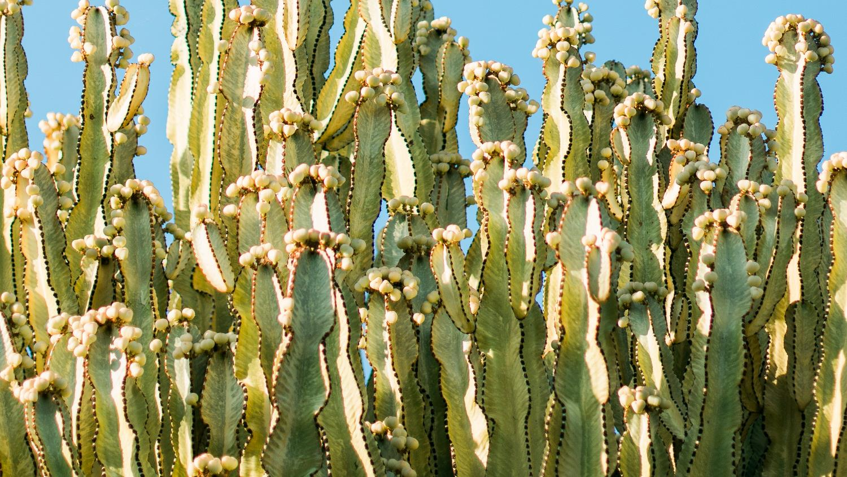
Plant Adaptations for Arid Lands Traci Klein, Matthew Katterman, and Arisbeth Ibarra Nieblas Funded by:

Slide 2
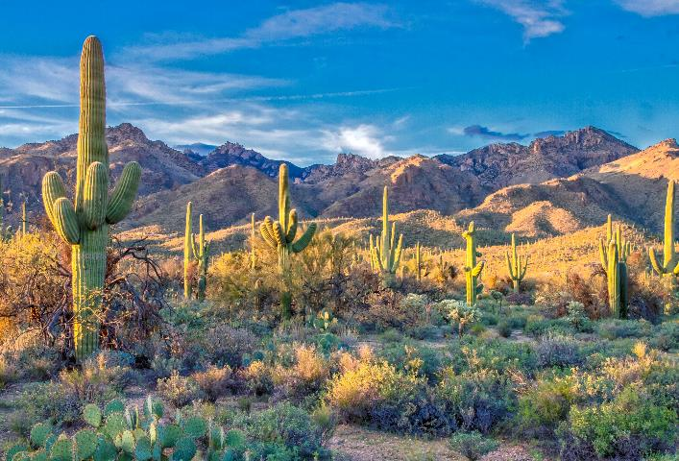
Think-Pair-Share Activity
What do you notice about plants in arid lands compared to plants in forests?
What are some of the conditions plants in arid lands experience compared to plants that live in forests?
Photo by Dulcey Lima on Unsplash
Notes:
Think, pair, share. Answers students should come up with are lack of water, high heat, strong sunlight, poor soils, high wind.
https://commons.wikimedia.org/wiki/File:Desert_Landscape.jpg

Slide 3
Adaptation
A change by which an organism or species becomes better suited to its environment.
Physical change
Behavioral change
Adapt (root verb)
Adaptation (a noun showing the process)
Notes:
Give examples 1) physical - our bodies are able to tolerate heat well, 2) behavioral – if it is hot outside you hang out in the shade under the trees

Slide 4
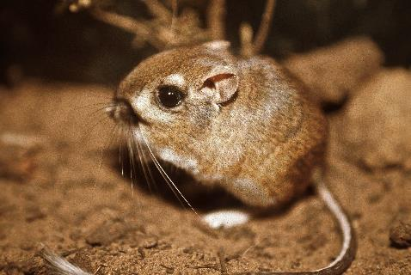
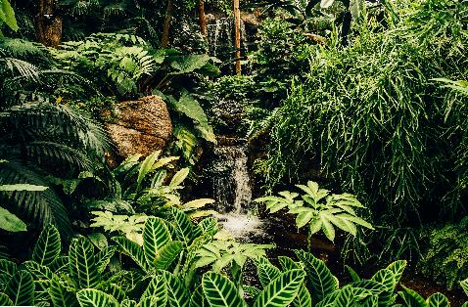
Examples of Adaptation
Physical: A kangaroo rat does not need to drink any water; it gets what it needs from just eating seeds.
Behavioral: You do not spend time in the hot sun in the middle of the day, but instead seek shade and air conditioning.
Physical: Some plants growing close to the ground in rainforests adapt by growing large leaves to catch light.
Notes:
Plant Photo: Free. Unsplash (Treeman)
Kangroo rat photo: wikipedia
1) Mention that with the kangaroo rat, the animal doesn’t pee when it goes to the bathroom, because it doesn’t drink water. Instead its waste is just small solid poop pellets. This is a physical adaptation it does., 2) May want to jokingly comment that if you’re choosing to be outside in the middle of the day during summer are you going to go on a 1 mile run? No, you’ll seek shade instead or air conditioning.

Slide 5
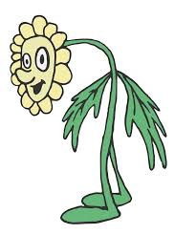
A special problem for plants:
They can’t move!
Can’t find a new place with more water
Can’t move to shade
Let’s review some specific plant
adaptations.
Take careful notes because you will be designing your own
imaginary desert plant with its own adaptations.
Notes:
https://www.kisspng.com/png-clip-art-flower-clipart-958541/preview.htm
Because plants can’t do the above mentioned activities they require special adaptations to deal with the extreme heat, sunlight, poor soil and lack of water. For plants they would need to develop both physical and behavioral adaptations to deal with these adverse conditions.

Slide 6
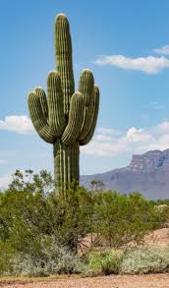
Saguaro (Carnegiea gigantea)
Spines dissipate heat and provide shade
Stores water in body
Main column can get wide like an accordion
Roots spread wide and shallow to gather rainwater
Special photosynthesis process where stomata (pores) only open at night when it is cooler, so it loses less water
Dissipate: (verb) 1. To disappear or cause to disappear. 2. To lose (heat, electricity, etc.).
Notes:
https://commons.wikimedia.org/wiki/File:Carnegiea_gigantea_or_Sahuaro_or_Saguaro_2.jpg
Comment that the saguaro has developed a lot of adaptations for the desert. 1) Mention to the students that the word dissipate has a similar meaning to ‘getting rid of’. Then give the official definition of dissipate to them. Refer to the lesson plan for this definition. Also mention that the spines in them are clustered towards the end of each arm or appendage., 2) Mention that the trunk or arms of the saguaro expand or contract depending if they have water or a lack of it., 3) Mention that the roots span or go out horizontally as far as the same height of the plant in all directions., 4) Mention that the type of photosynthesis they do is called CAM - Crassulacean acid metabolism and it is done during the nighttime different than the other types.

Slide 7
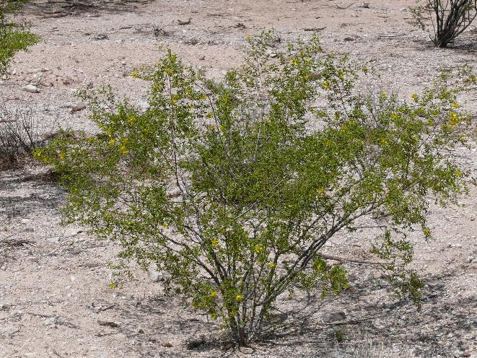
Creosote (Larrea tridentata)
Leaves have thick, waxy coating to prevent water loss
Leaves are small to prevent water loss
Notes:
Because it has this coating you can rub the leaves in your hands to feel and smell it. They give off a special ‘earthy’ smell. The waxy coating on the leaves is like having a good raincoat. Also, since the leaves are smaller there is less area for the water to escape.
https://commons.wikimedia.org/wiki/File:Creosote_Larrea_tridentata.JPG

Slide 8
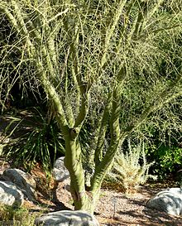
Palo Verde (Parkinsonia florida)
Leaves drop from tree in dry times
Photosynthesis occurs in the leaves and the bark---notice that the bark/trunk is green
Adds nitrogen to soil
Legume: (noun) A type of plant that produces long seedpods such as beans, peanuts, and lentils. Most legume plants have specialized groups of bacteria on their roots (called nodules) that convert nitrogen from the air and make it available in the soil for plant uptake.
Notes:
More information about nitrogen: https://www.phoslab.com/how-does-nitrogen-help-plants-grow/#:~:text=Nitrogen%20is%20a%20very%20important,and%20produce%20fruit%20or%20vegetables.&text=Nitrogen%20is%20part%20of%20the,for%20the%20plant%20through%20photosynthesis.
https://en.wiktionary.org/wiki/palo_verde
Mention for the second adaptation that the name of the plant itself means ‘green stick’ mainly due to the fact that it does photosynthesis in its trunk and branches. For the next adaptation mention the fact the adding nitrogen to the soil is the same term fixing the nitrogen or gathering and keeping it in the soil. Mention that this happens with plants called legumes. Give the definition of legume to the students as is recorded in the lesson plan.

Slide 9
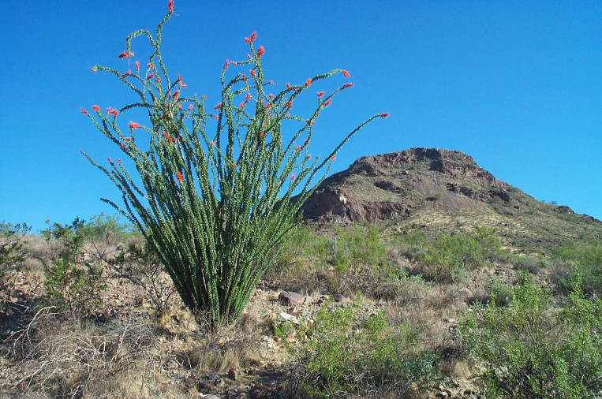
Ocotillo (Fouquieria splendens)
Leaves only appear after rain, drop off when dry
Has thick, waxy bark to retain water
Notes:
https://commons.wikimedia.org/wiki/File:Ocotillo.jpg
Comment that most of the year the ocotillo does not usually have leaves, just after a big rain does it grow them. Also similar to the creosote, having the thick waxy layer on the bark protects the plant similar to having a raincoat. This helps keep the water in it.

Slide 10
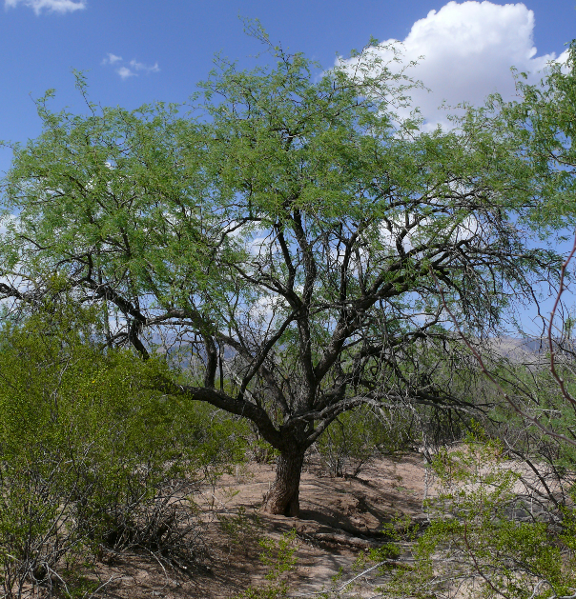
Mesquite (Prosopis velutina)
Small leaves to retain water
Very deep tap roots, to find water underground
Near Pima Mine, AZ they found a root more than 300 feet deep!
Adds nitrogen to soil
Notes:
https://commons.wikimedia.org/wiki/File:Velvet_mesquite.jpg
Tell them Mesquite has some similar traits to some of the other plants we already talked about. Like having the small leaves like the creosote does to save water. Say that the Palo Verde was another plant that was a legume – one that adds nitrogen to the soil. May also want to comment that 300 feet is similar to the length of a football field.

Slide 11
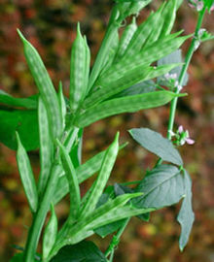
Guar (Cyamopsis tetragonoloba)
Deep tap roots
Needs to be watered only 3 or 4 times before beans are ripe
Adds nitrogen to poor soils
Likes heat, hates frost
Notes:
More information about nitrogen: https://www.phoslab.com/how-does-nitrogen-help-plants-grow/#:~:text=Nitrogen%20is%20a%20very%20important,and%20produce%20fruit%20or%20vegetables.&text=Nitrogen%20is%20part%20of%20the,for%20the%20plant%20through%20photosynthesis.
https://en.wikipedia.org/wiki/Guar
https://dl.sciencesocieties.org/publications/aj/abstracts/80/3/AJ0800030447?access=0&view=pdf
The guar like Mesquite has deep taproots. It also does not require a lot of water by looking at the number of times it needs to be irrigated. That is not a lot compared to other crops where you would need to water them every other week at least for the whole season. It is also a legume plant like Mesquite and Palo Verde. It does very well in the desert but you want to adapt it in places where it rarely freezes at night that much.

Slide 12
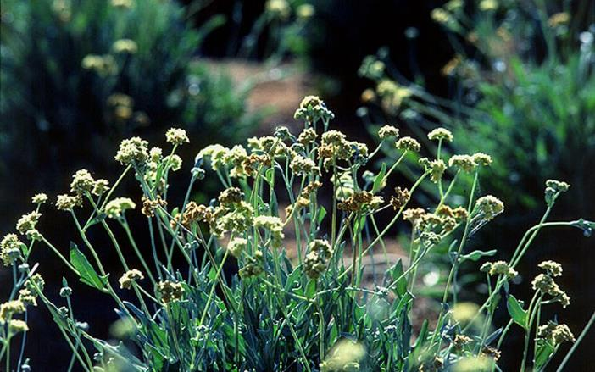
Guayule (Parthenium argentatum)
Native to Chihuahuan Desert
Produces rubber in the bark which helps it retain water
Produces resins which keep insects away
Gray leaves reflect sunlight
Notes:
https://en.wikipedia.org/wiki/Parthenium_argentatum
Comment that the Chihuahuan is the desert just to the east of us in Texas and Mexico. Having rubber in the bark is similar to how we would wear rubber boots to protect us and helps them to keep water in or retain it. At the end add that because the leaves reflect the sunlight the plant never really gets too hot in the summer.

Slide 13
Activity:
Design an imaginary plant that can live well in the desert.
Draw a picture, label, and include (and identify) three adaptations for your plant that will allow it to survive in the desert.
Label and explain the three adaptations in one to two sentences.
At least one of those adaptations should be an idea not shown in the slides or that we have discussed.
Notes:
Make sure to mention to students (before you start giving examples of plant adaptations starting with the saguaro) that you want to advise them to take plenty of notes about the plant adaptations you are going to go over for the next several slides. Mention at this point that they should have taken a lot of notes about the different kinds of adaptations from all of the desert plants and that they should think about using them when they design and draw their own desert adapted plant.

Slide 14
Optional: Gallery Walk (Presentations)
What are the most interesting adaptations?
How would these adaptations work under different conditions (high rain, cold temperatures, hotter temperatures?

Slide 15
Author Biographies
Traci Klein grew up mostly in Massachusetts, then came west to go to Brigham Young University. She graduated with a BA in Comparative Literature in 1993. After a stint in Salt Lake City, while her first husband went to medical school and their two boys were born, they moved to Tucson. Traci decided to switch fields and did graduate work in Plant Sciences at the University of Arizona and worked as a lab researcher for several years. After taking time at home to raise her sons, and after a divorce, she decided to dip her toes into education and began working as a long-term substitute in the Baboquivari School District on the Tohono O’odham nation while taking online education classes. She received her teaching certificate and has been teaching 7th-grade science at Valencia Middle School for 6 years. She has also been the MESA (Math Engineering Science Achievement) Club Advisor for 5 years. Currently, she is enrolled in the Masters in Educational Leadership program at Northern Arizona University and hopes to go into education administration. Matthew Katterman is a doctoral graduate student at the University of Arizona studying Biosystems Engineering. He is interested in irrigation engineering along with computer modeling of the guayule production system. He also has an intense interest in bioproducts and biofuels production. Matthew is a native of Tucson, Arizona, and received his Bachelor’s in Chemistry in 1997 as well as his Masters in Agricultural and Biosystems Engineering in 2004.
Arisbeth Ibarra Nieblas is a doctoral student in Environmental Engineering at the University of Arizona. She majored in Chemical Engineering at the Technological Institute of Sonora (ITSON), Ciudad Obregon, Mexico. Her graduate research involves developing a continuous corrosion monitoring station for water delivery pipe metal. As a fourth-year SBAR Fellow, Arisbeth continues to create educational content for middle school-aged students, including science experiments and activities that involve complex topics like bioeconomy.
Sustainable Bioeconomy for Arid Regions Center of Excellence: https://sbar.arizona.edu

