Slide 1
University of Arizona Guayule in a Bottle

Slide 2
Guayule in a Bottle

Slide 3
Vocabulary
Guayule - evergreen shrub native to the Southwest U.S.
Ecosystem - community of living and nonliving organisms
Variable – any factor, trait, or condition that can exist in differing amounts or types
Hydrologist – a scientist who studies how water interacts with Earth
Soil Infiltration - process by which water on the ground surface enters the soil
Niche - is the role and position a species has in its environment; how it meets its needs for food and shelter, how it survives, and how it reproduces.
Producers - Organisms that make their own food
Habitat - Natural home or environment of a species
Decomposers - Organisms that break down dead or decaying organisms

Slide 4
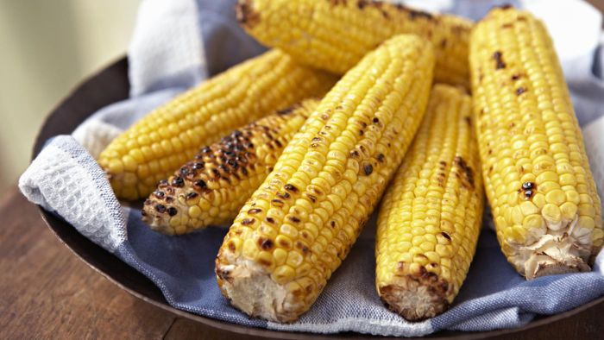
QuickWrite
What is your favorite food that is made with vegetables?
Where does this vegetable grow? (State, region, country)

Slide 5
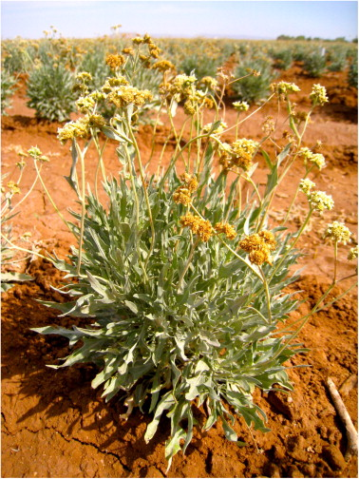
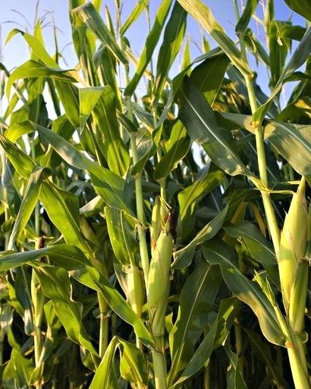
Purpose of experiment
How much water do Guayule seedlings and vegetable seedlings need to thrive?
VS

Slide 6
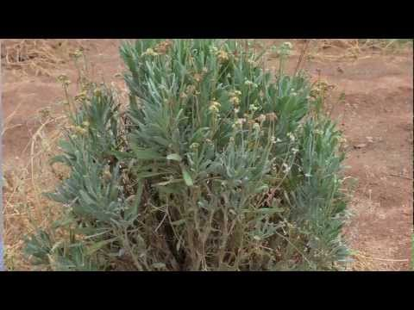
Research
Watch a short video on Guayule
https://www.youtube.com/watch?v=jwEgHpInBR4

Slide 7
Hypothesis
If the Guayule seedlings use (low or high) amounts of water then……… because
If the Vegetable seedlings use (low or high) amounts of water then……… because

Slide 8
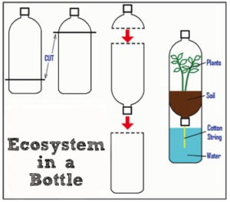
Experiment Materials
two water bottles
one bottle cap
3 pieces of Duck tape
one piece of heavy cotton string cut about 6 inches long
water
Your plant
Diagram: Copyright, Geof Hill, ITL Program, College of Engineering, University of Colorado Boulder
Notes:
String needs to be cotton- call Melissa for string

Slide 9
Experiment Directions
Step 1: Cut the two water bottles as shown
Step 2 Punch a hole in the bottom lid and place a cotton string through it. Secure the string by tying knot or duct tape.
Step 3 Fill the top portion with 8 – 10 cm of planting soil.
Step 4 Fill the bottom portion with water
Step 5 Plant one small plant in the soil.
Step 6 Using duct tape, connect the three pieces as shown.
Diagram: Copyright, Geof Hill, ITL Program, College of Engineering, University of Colorado Boulder
Notes:
String needs to be cotton- call Melissa for string

Slide 10
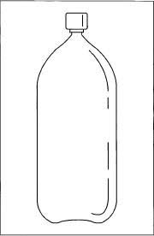
Experiment
Each day, one student will draw a line to show where the water line has moved to in a different color sharpie.
After at least a week we will analyze the results.

Slide 11
Daily Data Recording Observation Sheets
Date | Observation (Increase, decrease, the same?) Use your senses | Measurement

Slide 12
End of the introduction to the experiment.

Slide 13
Analysis
Date | Observation (Increase, decrease, the same?) Use your senses | Measurement

Slide 14
Analysis
What did you observe about the guayule plant?
What did you observe about the vegetable plant?
Which plant used the most water?
If a plant uses a lot of water, why is this a problem here in Arizona?

Slide 15
Conclusion
State the problem. Why did we do this lab?
State your findings, what happened?
Restate your hypothesis.
Reject/confirm your hypothesis
Discuss possible errors
What are future experiments we could design?

Slide 16
Analysis
At each station:
What type of plant is this?
What do you observe about the water usage?
How could the design be improved?

Slide 17
Conclusion
Whole group discussion:
Which plants used the most water?
Which plants used the least amount of water?
If a plant uses a lot of water, why is this a problem in Arizona?

