Slide 1
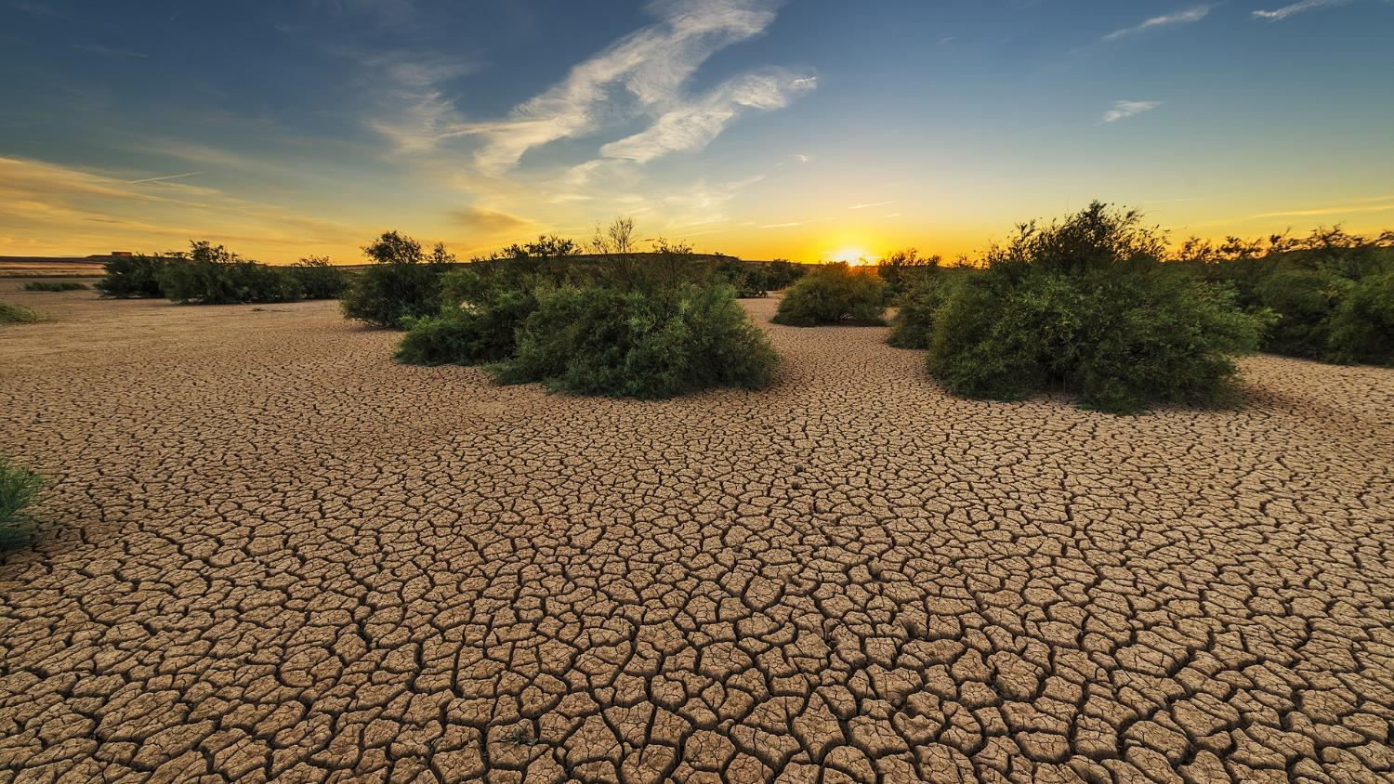


Droughts:
Causes and Types
Funded by

Slide 2
What do you know about “Droughts”?
Drought Brainstorm Activity
Type any ideas, definitions, and causes that relate to your understanding of a drought.
Type questions you have about drought conditions.
Droughts

Slide 3
Drought Research Activity
Go to www.drought.gov
Think about and use the observation template to answer the following questions:
What causes droughts?
Are all droughts the same? Why or why not?
What are some ways that droughts affect the land?
Complete the Drought Research Activity Worksheet
Notes:
Another activity could be to ask students to put their zipcode and to read about drought in their community.

Slide 4
Types of Drought: How they are created
Meteorological drought
Hydrological drought
Agricultural drought
Socioeconomic drought
https://drought.unl.edu/Education/DroughtIn-depth/TypesofDrought.aspx
Read this article for more specifics about each type of drought.
Source: NCDC.NOAA.GOV

Slide 5

Drought Matching Game
When a region has very little precipitation over a period of time.
Affects an economy—sales, production, jobs, or prices.
Meteorological
Drought
Socioeconomic
Impacts crops/agriculture
When there is a drop in surface or subsurface water. (ground water, lakes)
Agricultural
Hydrological
Drought
When surface and groundwater decreases
Hydrological
Weather causes less precipitation
Meteorological
When precipitation shortages cause less soil water & ground water for crops to grow.
Agricultural
Drought
Creates climate changes within an ecosystem
Ecological
Socioeconomic
Drought
When drought conditions make it hard to grow or harvest goods. (livestock, crops, forage)
When there is a prolonged & widespread decrease in water supplies on an ecosystem.
Ecological
Drought
Video Credit
Water Droplet Evaporating Gif by Gif Bomb/YouTube

Slide 6
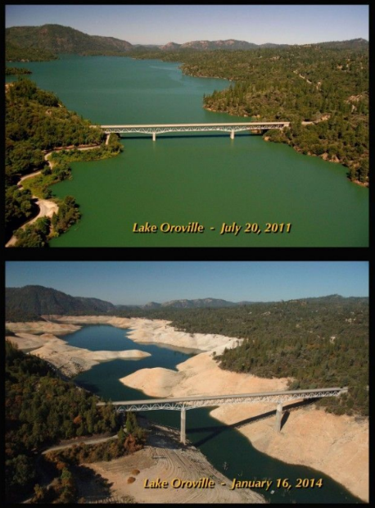
Before and After Photo Analysis Activity
E
For the following six photo pairs, answer these questions:
Which photo reflects the most rapid change? How do you know?
Which photo reflects change caused by human actions?
How do you know?

Slide 7
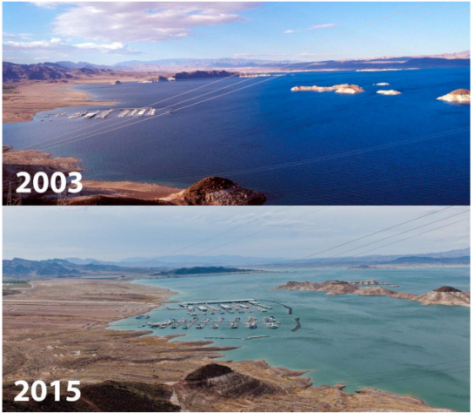
Before and After Photo Analysis Activity
A
B
Lake Powell 2000 and 2005
Source: NASA
Colorado River

Slide 8
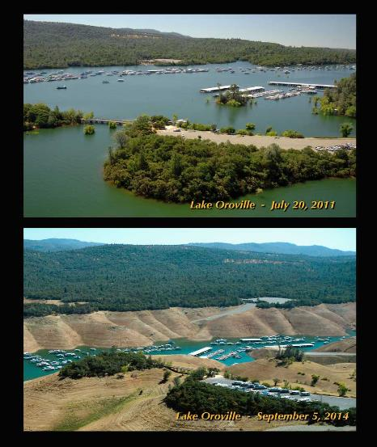
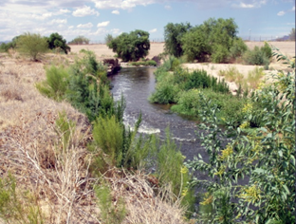
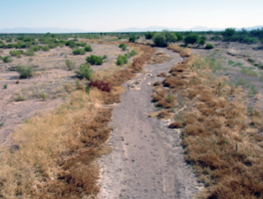
Before and After Photo Analysis Activity
D
C
1904 2019
Santa Cruz River
Source: Environmental Protection Agency

Slide 9
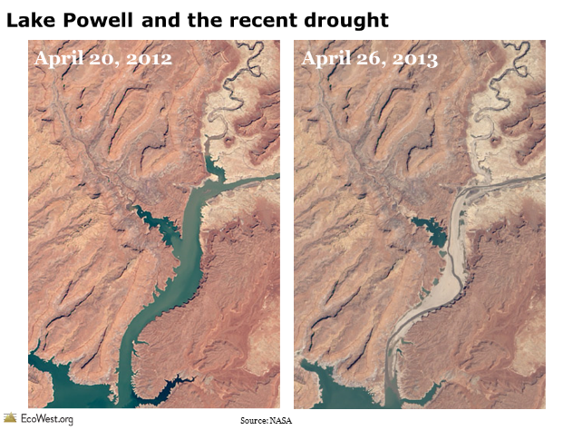
Before and After Photo Analysis Activity
Lake F

Slide 10
Before and After Photo Analysis Activity Worksheet
Analyze the two photos showing the impacts of drought on rivers over time. Look for similarities and differences.
What changes do you see that could impact plants, animals, and human communities?
Hypothesize what caused the changes in the river or lake.
Complete the Before and After Photo Analysis Activity Worksheet

Slide 11
Drought Illustrative Model
Choose one type of drought.
Using colored pencils and blank white paper, create a drawing of one type of drought conditions. Use specific details.
Using scientific vocabulary, label your drawing - use at least 8 of the following vocabulary words in your model.
Include a definition for the type of drought.
Include a cause for that type of drought.
Include how humans may contribute to that type of drought.
Write your name, date, class period on the back.
Science Vocabulary:
Heat 11. Drying
Evaporation 12. Soil
Erosion 13. Surface Water
Drought 14. Subsurface Water
Meteorological 15. Weathering
Agricultural
Hydrological
Socioeconomic
Ecological
Water Cycle

Slide 12
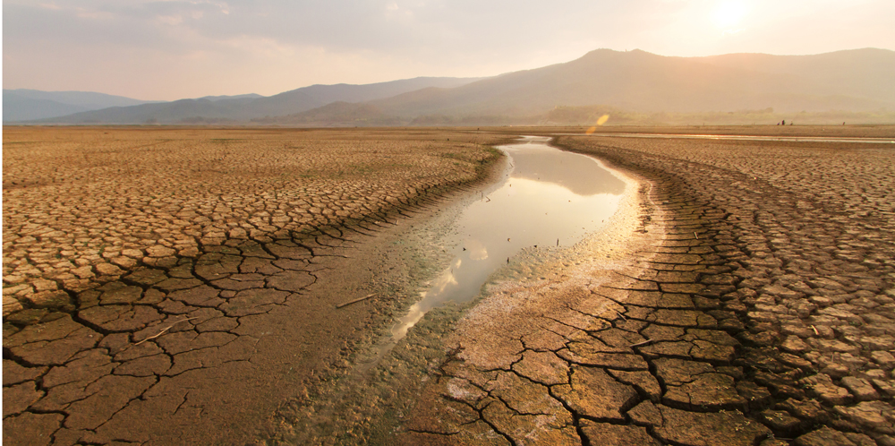
Drought Model – Example **do not copy**
Drought Definition – Evaporation of water Surface Water Heat from Sun
Caused by –
Humans help create this type of drought by
Dry Soil
Photo Credit:
Bertrand Richaud
1-28-2020
DHI Reservoir/blog.dhigroup.com

Slide 13
What about droughts would you like to know more about?
Is there currently a drought happening in your region? What type of drought is it? Ask a family member or friend.
No, there are not drought conditions in our area right now. Explain why they think this:
Yes, we are in a drought right now in our area. Explain why they think this:
Notes:
droughts would like to know more about?

Slide 14
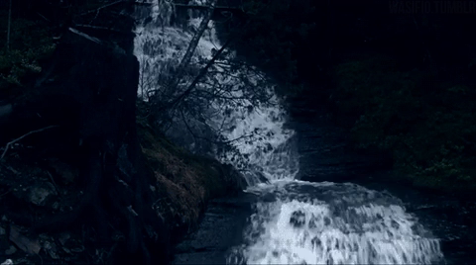
Keep Exploring!

Slide 15


Author Biographies
Rodrigo Rosalez is a second-year graduate student in the Department of Chemical and Material Engineering (CHME) at NMSU. He obtained his Bachelor Degree at NMSU and is an SBAR Fellow.
As a first-generation college student, he wants to continue his academic work to become a community college instructor or a university professor where he will be able to teach others what he learned and encourage students to continue their own education. As an SBAR Fellow, he is proud to work with Cathy Bradley in Lynn Middle School, Las Cruces, NM, to encourage/spread education related to our current situation as well as promoting SBAR in the process.
Cathy Bradley has been teaching middle school science for 10 years with a passion and drive that inspires students to dig further. Ms. Bradley is licensed in both Special Education and Sciences (K-adult) in the state of New Mexico. Prior to her educational career, Ms. Bradley was a Medical Technologist for over 20 years, working in medical laboratories performing medical testing using various analyzers and equipment. She brings in an understanding of skills needed to be successful in science careers and communication as well as an understanding of gathering, analyzing, and using data to predict and modify for best results or performance.
Karina G. Martinez-Molina , is a second year PhD graduate student in the Department of Arid Lands Resource Sciences at the University of Arizona. She earned a bachelor’s degree in Industrial and Environmental Engineering from Sonora State University (Mexico), and a Master’s in Development Practice from the University of Arizona funded by Mexican Ministry of Energy through the National Council for Science and Technology. She has been working as a Research Associate at the Udall Center for Studies of Public Policy on binational projects focusing on green infrastructure, urban agriculture, renewable energy and society as well as transboundary wastewater management (Mx-US).
Any opinions, findings, conclusions, or recommendations expressed in this PowerPoint lesson are those of the author(s) and do not necessarily reflect the view of the U.S. Department of Agriculture. Grant # 2017-68005-26867.

