Slide 1
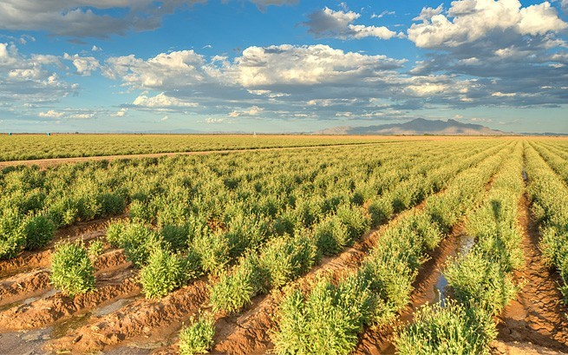
Biopolymers: Building Blocks of Life

Slide 2
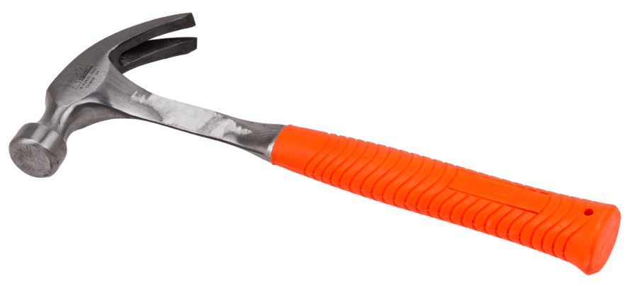
What is the function of the hammer?
What is a hammer good for?
What is the structure (shape) of the hammer?
How does the hammer’s structure help it work well?
Slide 2

Slide 3
Monomers & Polymers
Monomer (noun): a single atom or molecule; “mono” = one
Polymer (noun): a large molecule formed from monomers, which may have a repeating pattern; “poly” = many
Polymerize (verb): to link together to form a chain; for example, monomers link together to form polymers
Slide 3

Slide 4
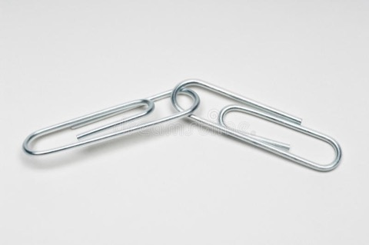
Activity: Building Polymers
THE RULES:
Green paperclips are initiators (“go”): start a new chain
Red paperclips are terminators (“stop”): stop adding to the chain and set the chain aside
Gray paperclips are connecting monomers: add to a chain (attach to a green or gray paperclip)
Start with five green paperclips
Take turns adding new paperclips to each chains
Slide 4

Slide 5
Data Analysis
Line up the chains from shortest to longest
Count the number of chains that are dimers (2-long)
Count the number of chains that are trimers (3-long)
Count the number of chains that are 4 long…5 long…6 long…
Report to the group
Slide 5

Slide 6
Data Analysis
Using the lengths of your chains, calculate the:
Average (mean) chain length: count the total number of paper clips and divide by the number of chains
Minimum: report the length of the shortest chain
Maximum: report the length of the longest chain
Median: with the chains in order from shortest to longest, find the length of the chain in the middle
Slide 6

Slide 7
Monomers & Polymers
Monomer (noun): a single atom or molecule; “mono” = one
Polymer (noun): a large molecule formed from monomers, which may have a repeating pattern; “poly” = many
Polymerize (verb): the process of monomers linking together to form polymers
If a saccharide is a sugar molecule, what is a polysaccharide?
If rubber is a polyisoprene, what is rubber made of?
Slide 7

Slide 8
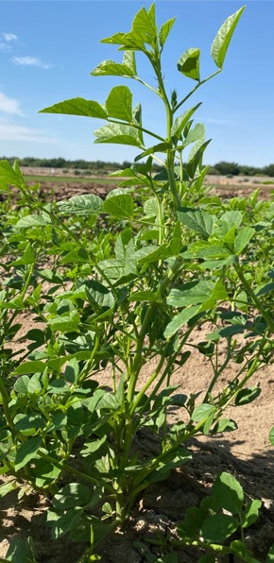
How do plants make glucose monomers?
Photosynthesis is a chemical process used to transform carbon dioxide (CO₂) and water (H₂O) with the help of light energy into a carbohydrate (C₆H₁₂O₆) and oxygen (O₂).
$$Light+{6H}_{2}O+6CO_{2}→C_{6}H_{12}O_{6}+6O_{2}$$
Here, the carbohydrate is glucose.
In the picture, the potato plant makes glucose
and stores the glucose as starch.
Slide 8

Slide 9
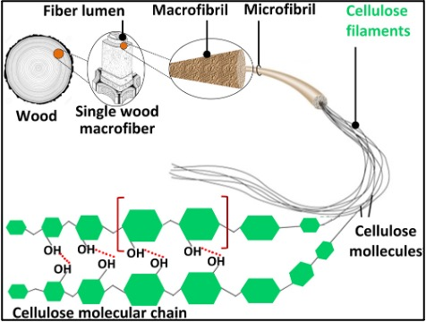
Polymers in plants
Plants make several kinds of monomers following certain rules.
Plants make different polymers for different functions.
For example, plants form long, straight chains of glucose (cellulose) that can be stacked on top of each to form a strong structure to stand tall.
Slide 9

Slide 10
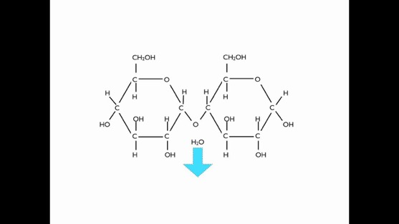
How do plants make polymers?
Starch is manufactured in the green leaves of plants from glucose produced during photosynthesis and serves the plant as a reserve food supply.
Polysaccharide polymerization uses dehydration to connect glucose monomers.
$${nC}_{6}H_{12}O_{6}→{\left({ C}_{6}H_{10}O_{5}\right)}_{n}{+nH}_{2}O$$
Slide 10

Slide 11
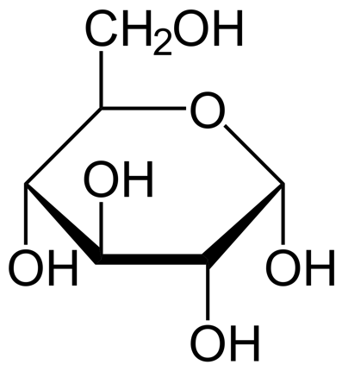
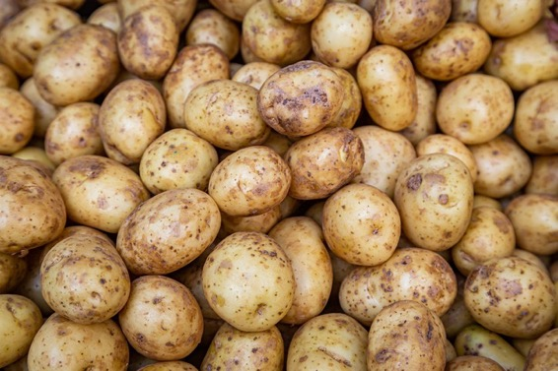
Monomer and Polymer Examples
Starch
Polysaccharide
Glucose
A type of sugar
Monomer
Polymer
Slide 11

Slide 12
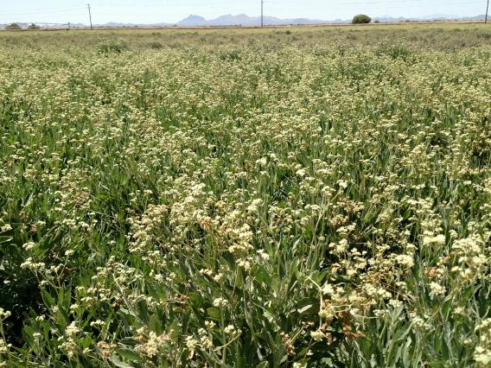
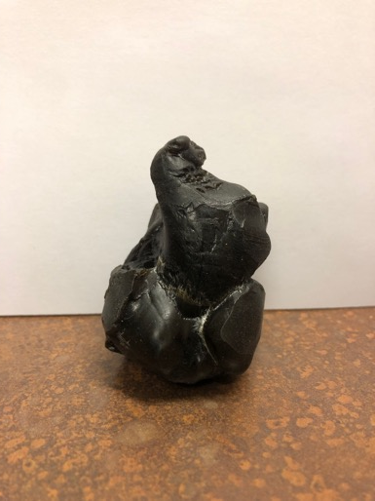
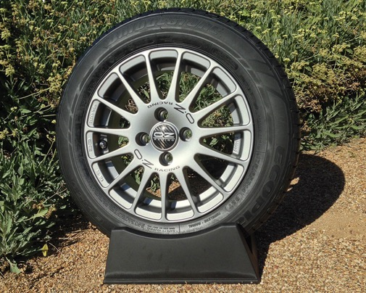
GUAYULE
Guayule shrubs produce natural rubber polymers called polyisoprene that can be used for tires or latex gloves.
Slide 12

Slide 13
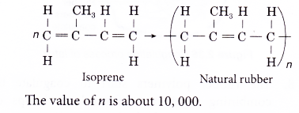
How do plants make polymers?
Natural rubber from Hevea rubber trees are made from n-isoprene monomers to form polyisoprene (rubber).
Slide 13

Slide 14
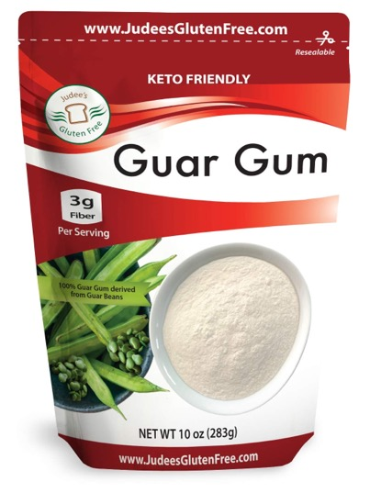
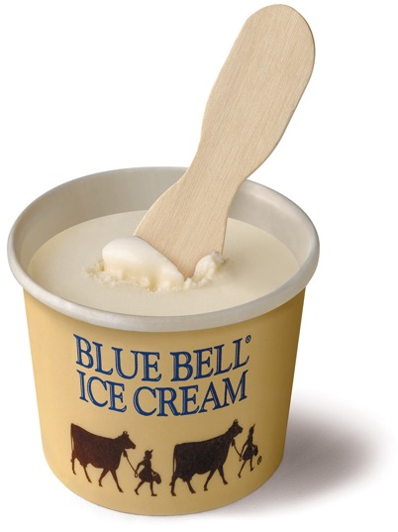
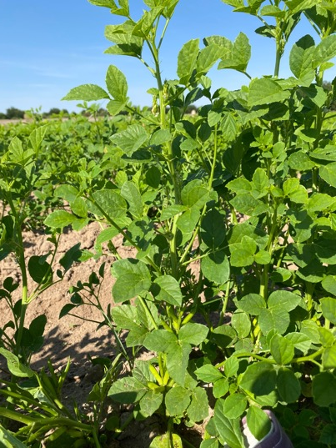
Special Plant Polymers for Arid Regions
Guar
Guar is grown for the unique polymer in seeds. Guar gum is a kind of polysaccharide used in ice cream as a thickener.
Slide 14

Slide 15
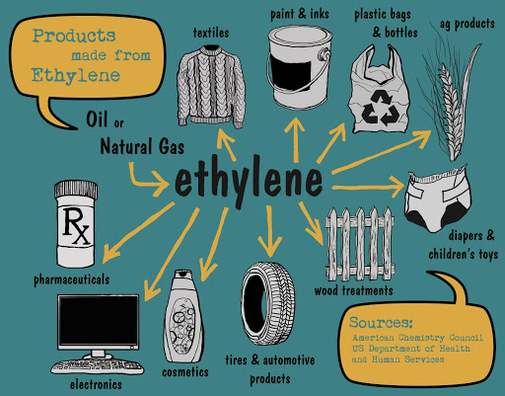
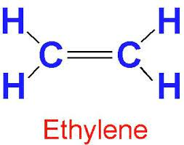
Monomer and Polymer Examples
Products formed by ethylene
Polyethylene
A molecule of ethylene
Part of crude oil
Monomer
Polymer
Slide 15

Slide 16
Take this hammer as an example:
What is the function of the hammer?
What is it supposed to be good for?
How does the shape help a hammer function well?
What is the structure of the hammer?
Slide 16

Slide 17
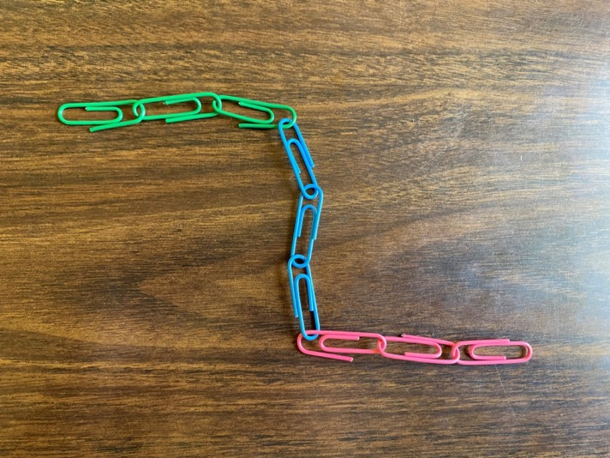
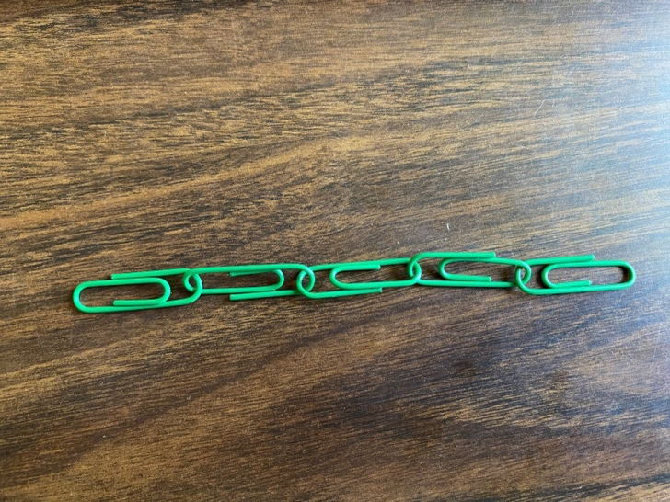
How do the structures you built relate to polymers?
Starch can form in chains with bends:
Starch can also form in straight, or linear, chains:
Slide 17

Slide 18
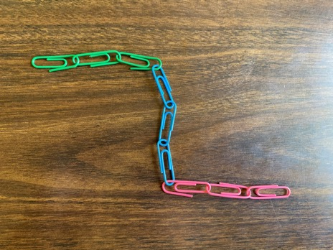
Structure determines Function
Chains with bends provide spaces for enzymes to break down starch into glucose for a plant to consume.
Linear chains provide easily stackable polymers.
Slide 18

Slide 19
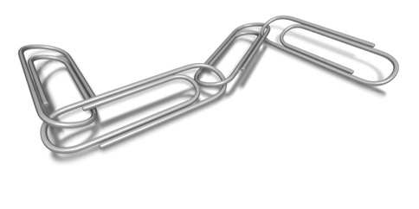
Activity II: Building 2-D Polymers
THE RULES:
Green paperclips are initiators (“go”): start a new chain
Red paperclips are terminators (“stop”): stop adding to the chain and set it aside
Gray paperclips are connecting monomers: add to a chain (attach to a green or gray paperclip)
Slide 19

Slide 20
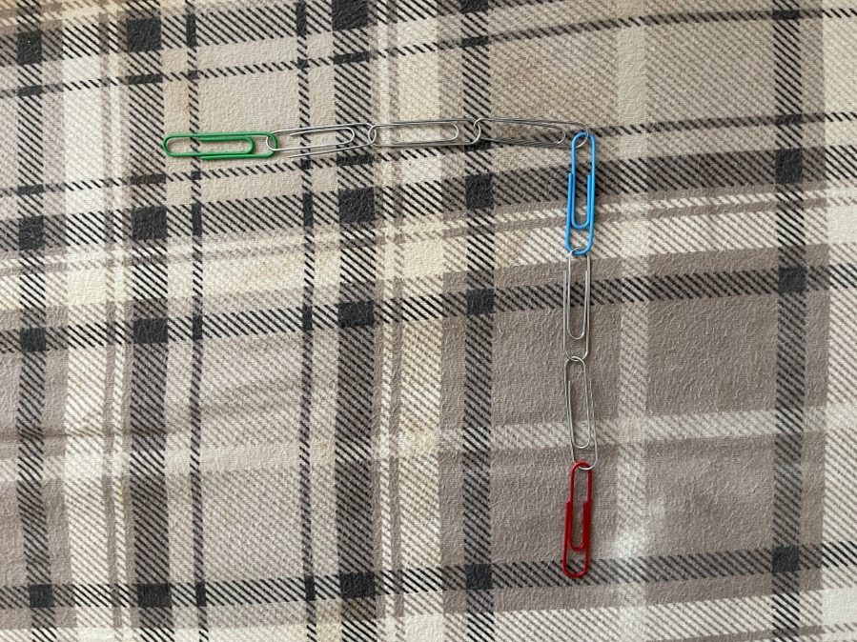
Activity II: Building 2-D Polymers
THE RULES:
Blue paperclips create a 90-degree turn (bend): add to a chain (attach to a green or grey paperclip) but at a 90-degree angle so that the chain bends (turns) to form a corner
Slide 20

Slide 21
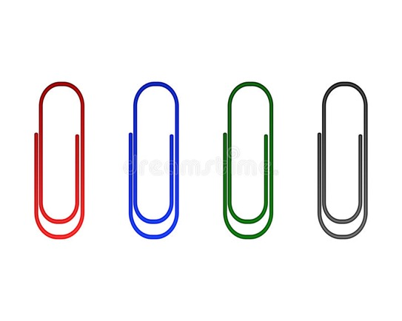
Rules of the Paper Clips
Each of the paper clip is a monomer.
Each paper clip has a different rule,
green paper clip (initiate, go)
red paper clip (terminate, stop)
blue (create a 90-degree turn)
gray (continue the straight chain)
Start with five green paperclips and take turns building chains
Slide 21

Slide 22
Data Analysis
Sort the chains into groups with no bends (straight chains), one bend, two bends, etc., then arrange each group shortest to longest
Fill in the data table on your worksheet to show your data
# of chains | No bends | One bend | Two bends | …
Dimer (2-long)
Trimer (3-long)
Tetramer (4-long)
Pentamer (5-long)
Hexamer (6-long)
…
Slide 22

Slide 23
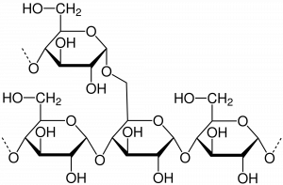
Polymers in Plants
Plants can form starch.
Starch is used to store energy in two different forms
Amylose chains are joined by glycosidic bonds that form spiral shapes. A spiral shape can compact tightly to pack more energy into a smaller space for storage.
Amylopectin chains are joined by glycosidic bonds creating branches. Branches provide space for enzymes to hydrolyze (break down) bonds when a plant needs glucose quickly.
Amylopectin
Amylose
Slide 23

Slide 24
Questions
What else do we make from plants?
How did the plants make these materials?
What other polymers do we use that are not made by plants?
Slide 24

Slide 25
Authors Biographies
Shermal Fernando is a PhD student in the Department of Chemical and Materials Engineering at the New Mexico State University.
Darien Pruitt is a Masters student at New Mexico State University studying mycorrhizal fungi associations in legumes and nutrient management in guar. In 2013, she earned her Bachelors degree in Biology from NMSU. Darien grew up in Hobbs, NM, where she learned how to garden and care for plants. Later, she became interested in agriculture and sustainability while finishing high school and completing her Bachelors degree. Her future goal is to work in sustainable agricultural systems across the Southwest and will eventually pursue her Ph.D. in the same field.
Catherine Brewer is an associate professor in the Department of Chemical and Materials Engineering at New Mexico State University.
Sustainable Bioeconomy for Arid Regions Center of Excellence: https://sbar.arizona.edu
Any opinions, findings, conclusions, or recommendations expressed in this PowerPoint lesson are those of the author(s) and do not necessarily reflect the view of the U.S. Department of Agriculture. Grant # 2017-68005-26867.

